Slide 1
The Cloud for Modern Business
Francesco Scullino
Microsoft Innovation Center

Slide 2
Why the cloud?
Rapidly setup environments to drive business priorities
Scale to meet peak demands
Increase daily activities, efficiency and reduced cost.
Speed
Scale
Economics

Slide 3

28
Azure regions around the world
Hyper-scale footprint
Latest launch was in October 2015- India – Central, India – South, India – West
GENERALLY AVAILABLE
6 new regions announced: Canada Central, Canada East, Germany Central,
Germany North East, United Kingdom (2 – regions TBD)
More than AWS and Google Cloud combined
Azure regions

Slide 4
Hyper-scale
Azure
Enterprise proven
Hybrid

Slide 5




















Microsoft Azure
Cloud Infrastructure
Compute
Security + Management
Networking
Hybrid Operations
Developer + App Platform
Visual Studio Family + Azure App Service
Virtual Machines
Active Directory
Express Route
Azure AD Connect Health
Containers
Multi-Factor Auth
Virtual Network
AD Privileged Identity Mgmt
Data + Analytics
Cortana Analytics Suite
Remote App
Automation
Load Balancer
Backup
Batch
Key Vault
DNS
Operational Insights
Internet of Things
Azure IoT Suite
Storage
Traffic Manager
Import/Export
Blob Storage
Azure Files
Premium Storage
VPN Gateway
StorSimple
Cloud Infrastructure
Azure + Azure Stack + Operations Management Suite
Application Gateway
Site Recovery

Slide 6
Virtual Machines
Getting started
Select image and VM size
New disk persisted in storage
Management portal
Windows Server
Boot VM from new disk
>_
Linux
Scripting
(Windows, Linux and Mac)
Blob Storage
General Purpose
Basic
Standard
Optimized Compute
Performance Optimized
Network Optimized
REST API
Cloud
Comprehensive
Networking

Slide 7
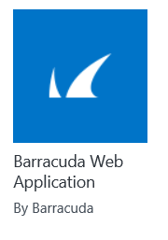
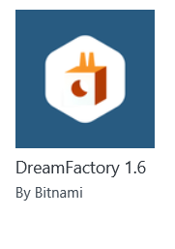
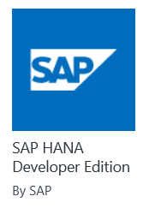
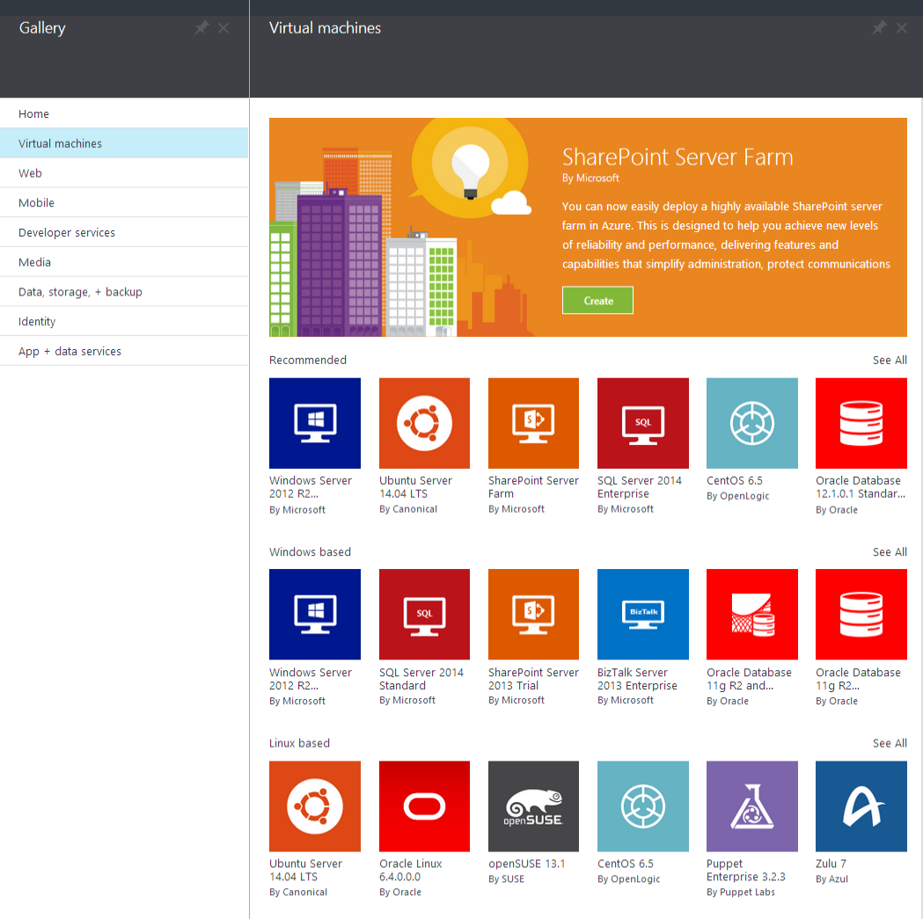

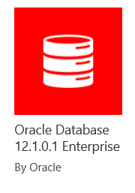
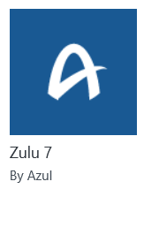
Microsoft Azure
Certified

Slide 8
Demo: Azure Portal
Notes:
Certified Virtual Machines with Load Balancer.

Slide 9













Microsoft Azure
Leading the journey to the Cloud
Developer + App Platform
App Platform Services
Integration
Development Tools
Media & CDN
SAAS Solutions
Microsoft Dynamics
Content Delivery Network
App Service
Storage Queues
Visual Studio
Microsoft Azure
Notification Hubs
BizTalk Services
Visual Studio Online
Media Services
Enterprise Mobility
Microsoft Enterprise Mobility Suite
Developer + App Platform
Visual Studio Family + Azure App Service
API Management
Hybrid Connections
Application Insights
Cortana Analytics Suite
Data + Analytics
Service Fabric
Service Bus
Azure SDK
Cloud Services
Internet of Things
Azure IoT Suite
Cloud Infrastructure
Azure + Azure Stack + Operations Management Suite

Slide 10
Agility

Slide 11
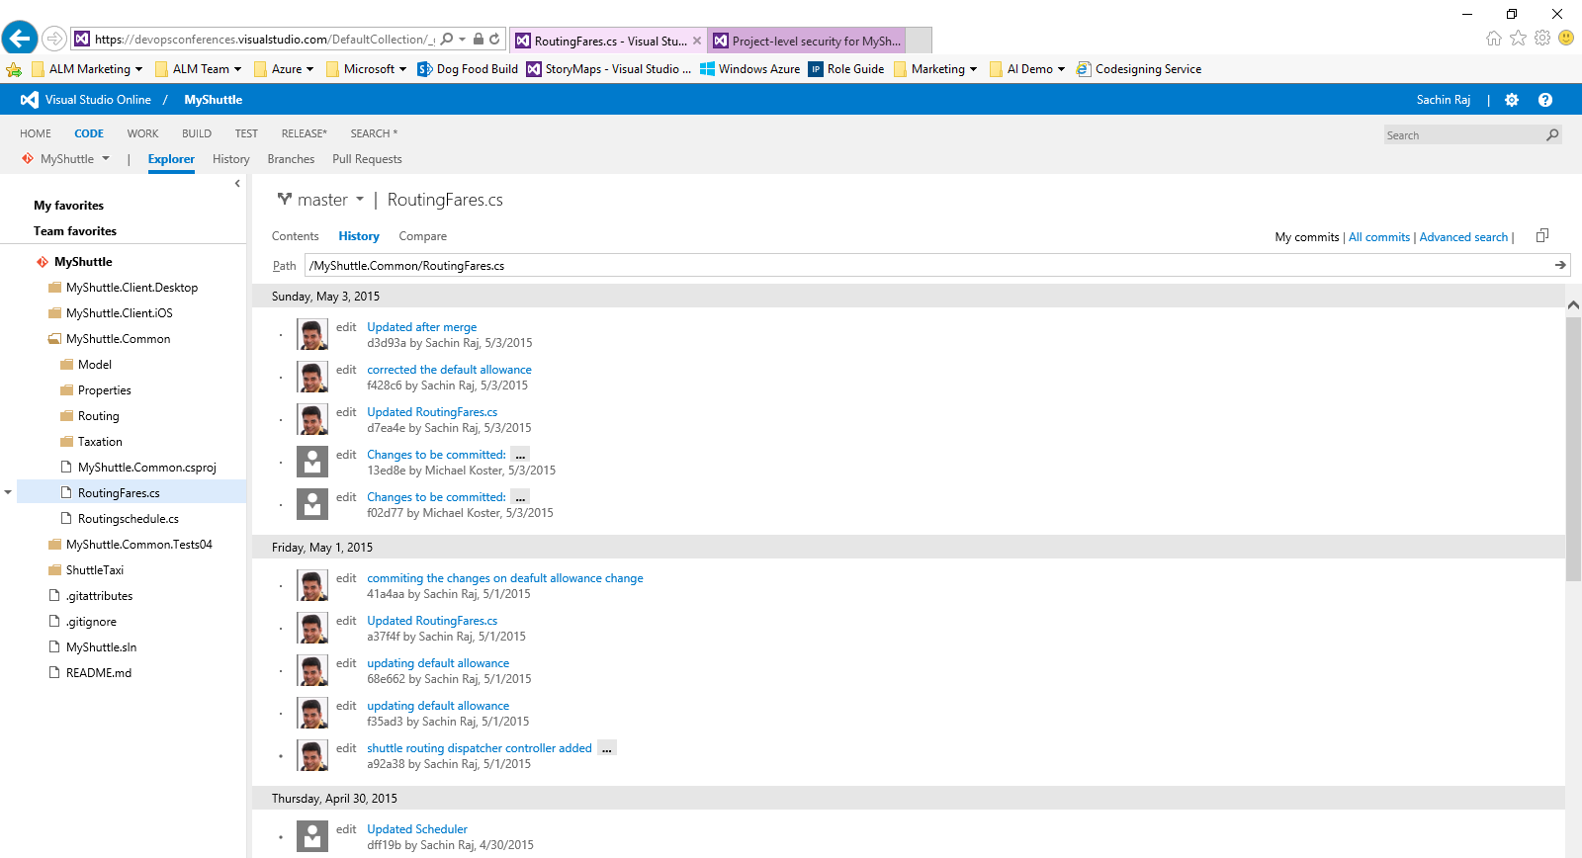
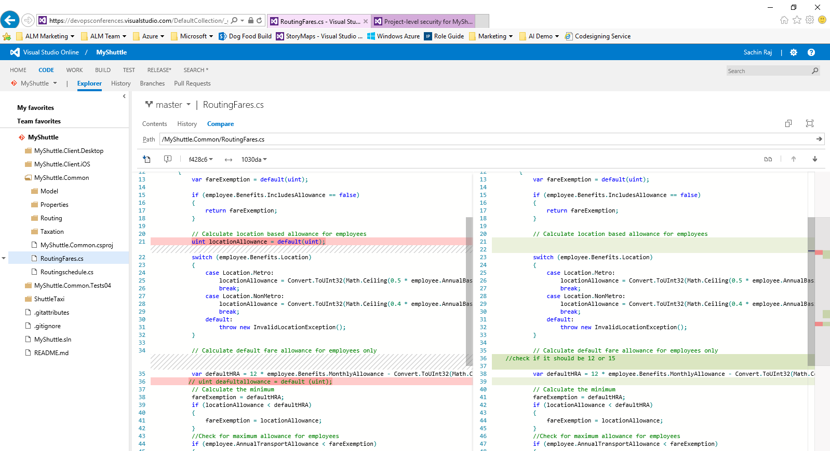
Visual Studio Online
Visual Studio Online: Code Repository
Code Repository
Build + Deploy
Load Testing
Release Management
Azure
Visual Studio
Eclipse / XCode
Application Insights and Hockey App

Slide 12
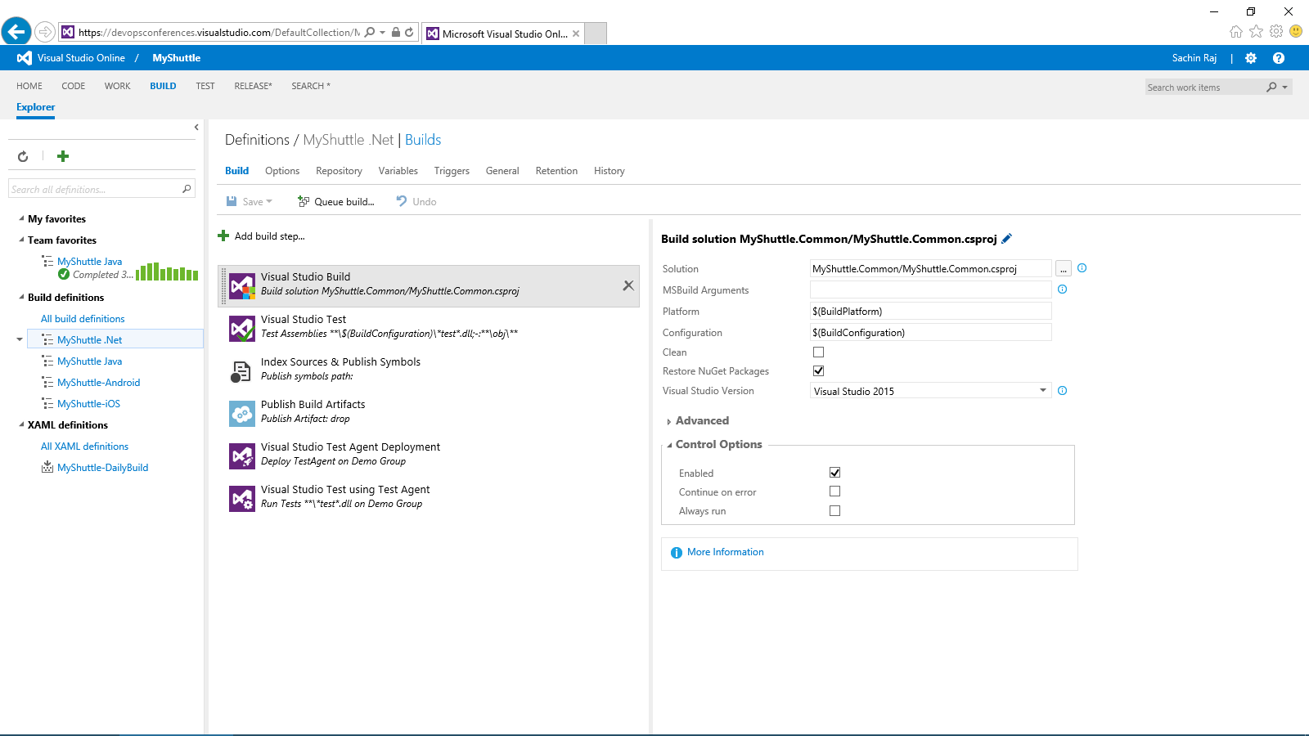
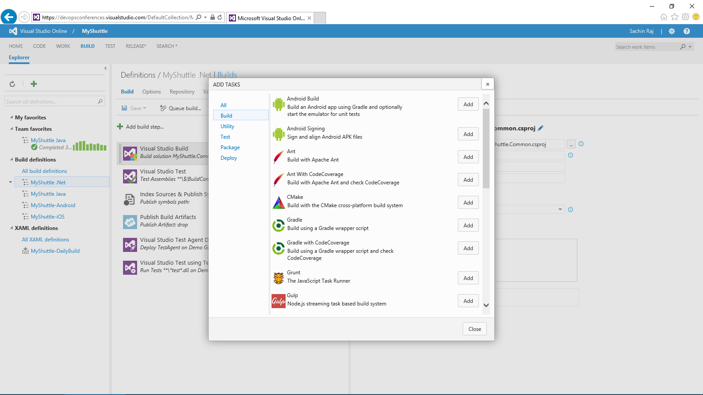
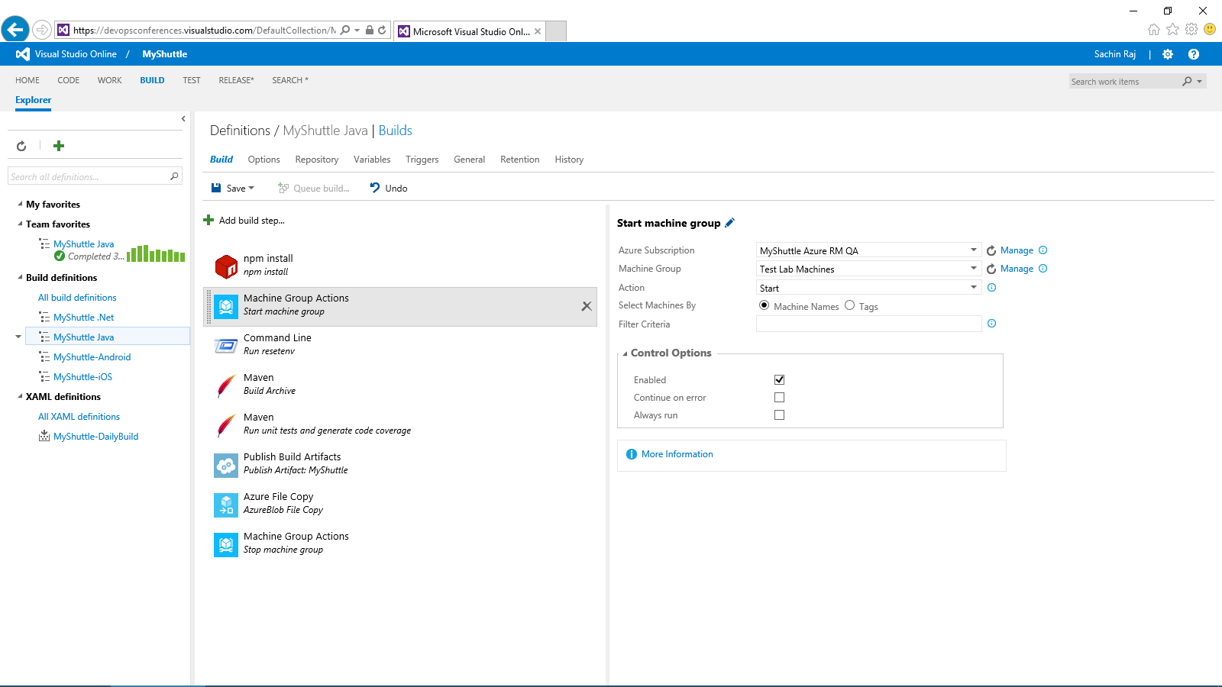
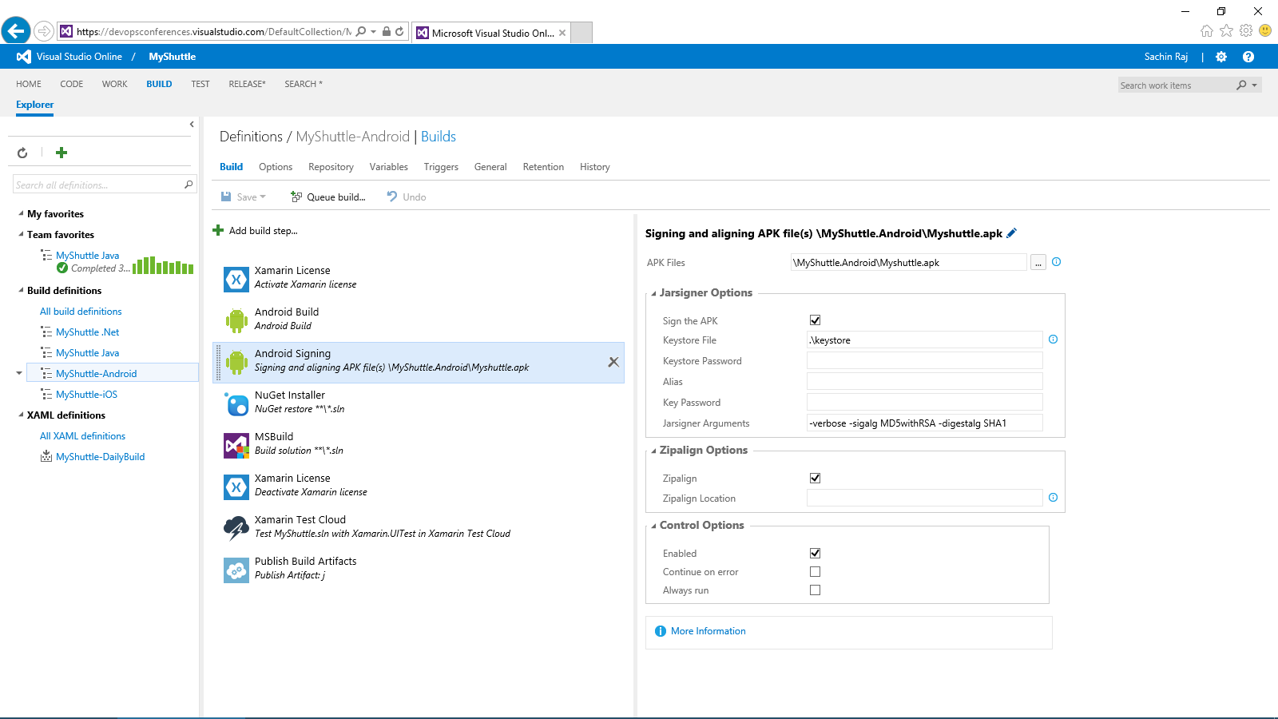
Visual Studio Online: Build + Deploy
Code Repository
Build + Deploy
Load Testing
Release Management
Azure
Visual Studio
Eclipse / XCode
Application Insights and Hockey App

Slide 13
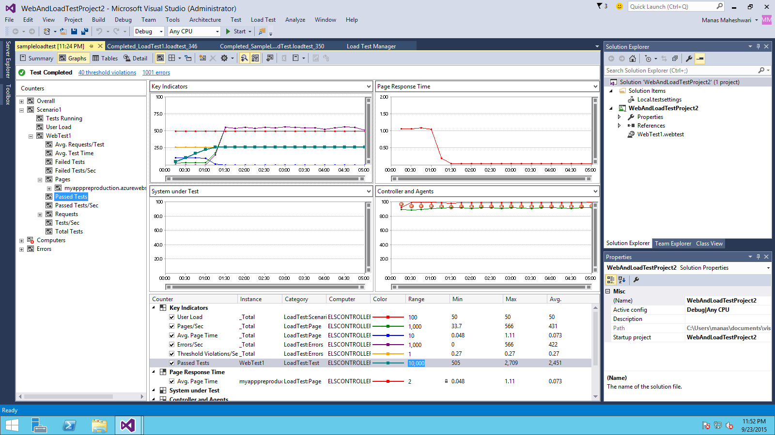
Visual Studio Online: Load Testing
Code Repository
Build + Deploy
Load Testing
Release Management
Azure
Visual Studio
Eclipse / XCode
Application Insights and Hockey App

Slide 14
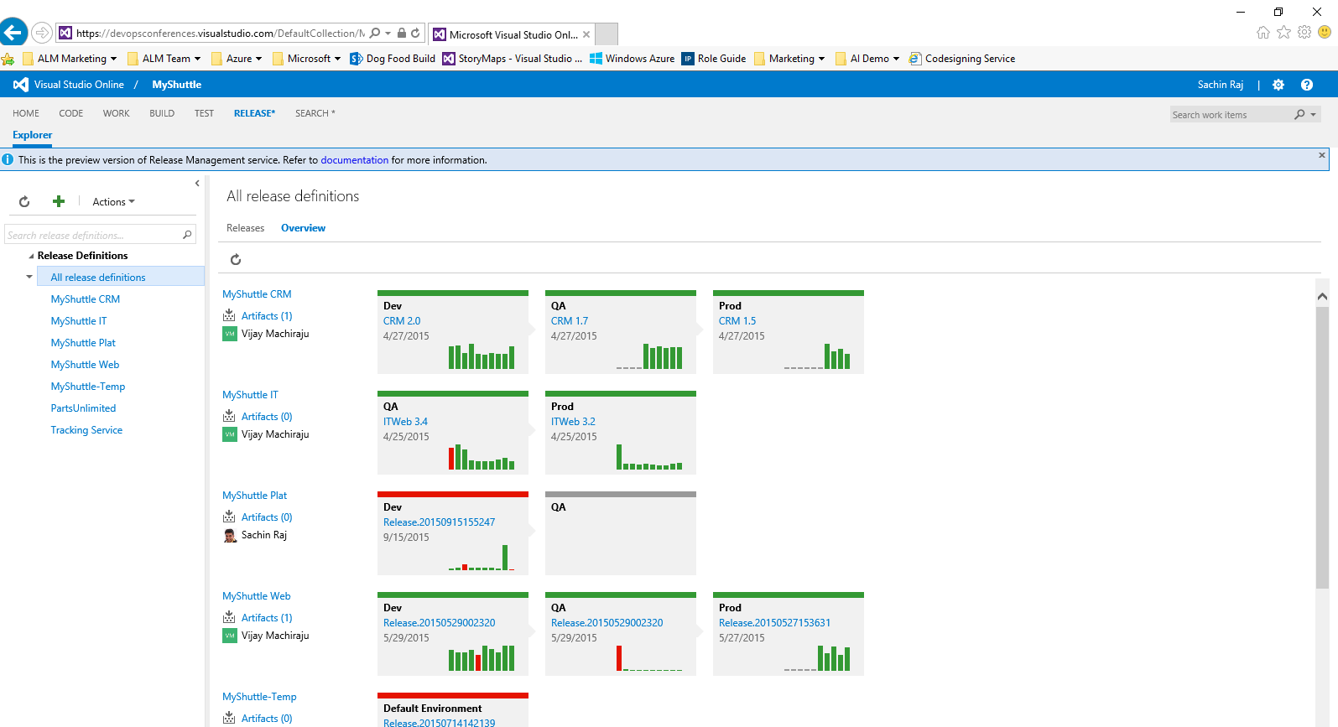
Visual Studio Online: Release Management
Code Repository
Build + Deploy
Load Testing
Release Management
Azure
Visual Studio
Eclipse / XCode
Application Insights and Hockey App

Slide 15
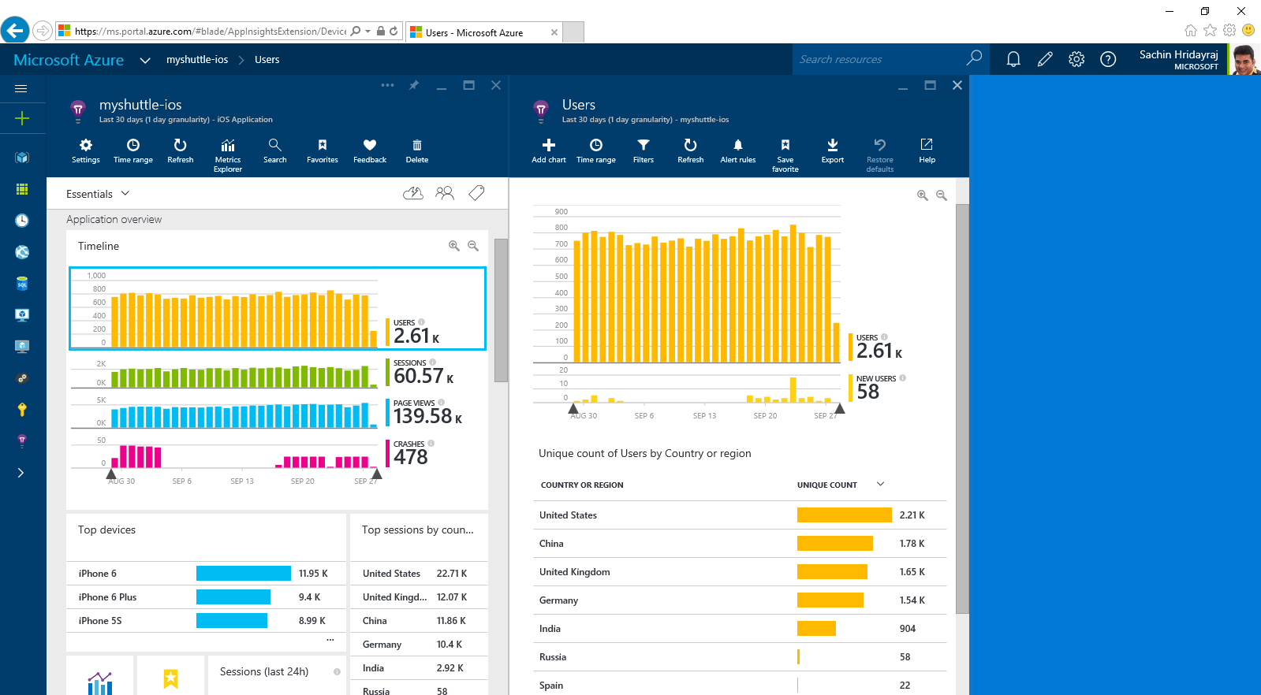
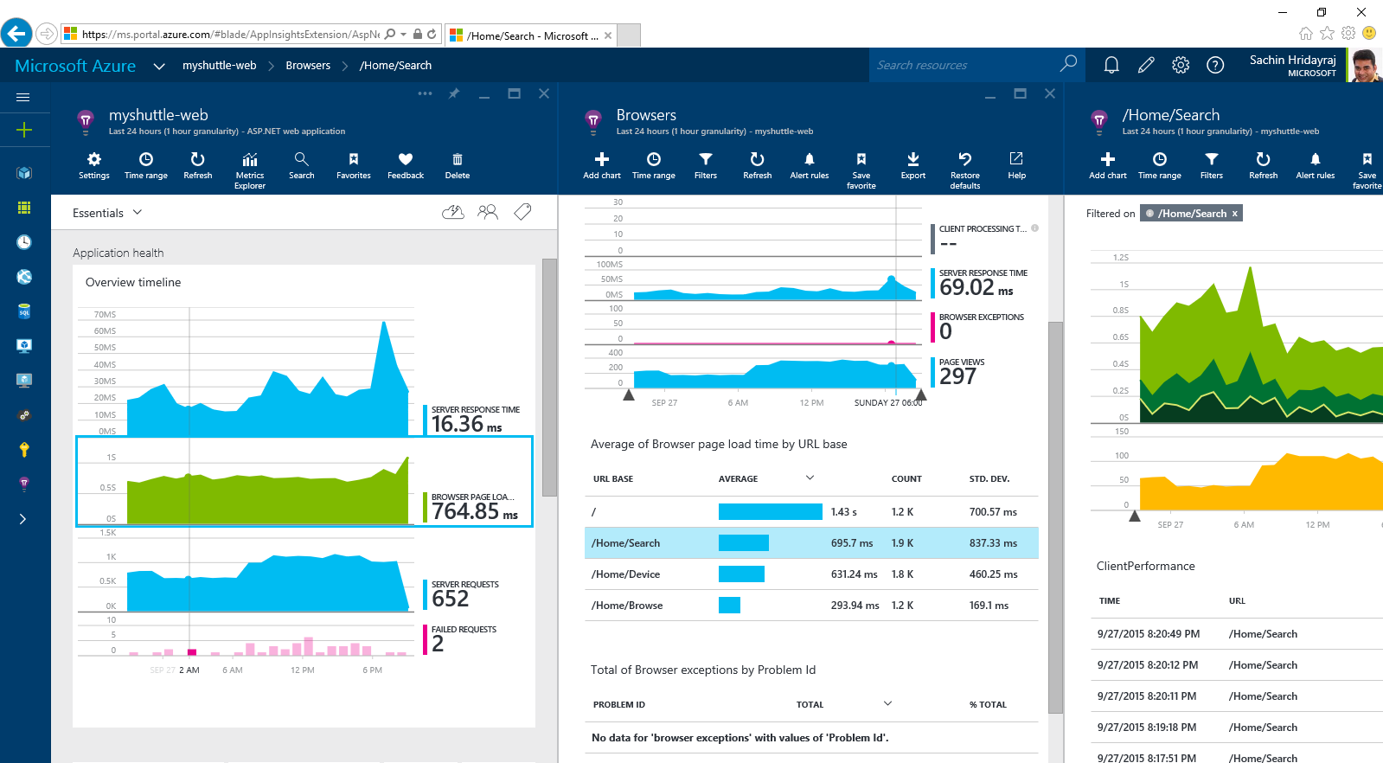
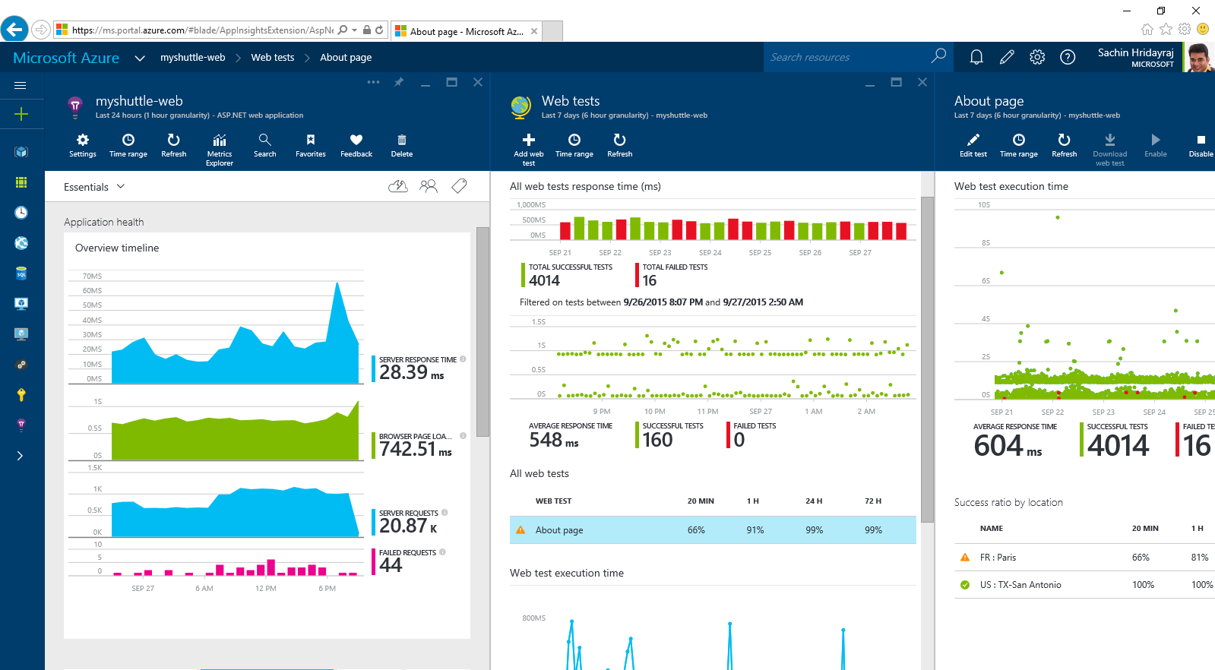
Visual Studio Online: Application Insights
Code Repository
Build + Deploy
Load Testing
Release Management
Azure
Visual Studio
Eclipse / XCode
Application Insights and Hockey App

Slide 16
Visual Studio Online: DevOps
Code Repository
Build + Deploy
Load Testing
Release Management
Azure
Visual Studio
Eclipse / XCode
Application Insights and Hockey App

Slide 17


Azure App Service Build and scale great cloud apps
Web Apps
Mobile Apps
Logic Apps
API Apps
.NET, Java, Node.js, PHP, Python
Auto patching
Auto scale
Integration with existing apps
Continuous deployment
Notes:
App Service has everything you need to build apps that target both web and mobile clients from a single app back-end.
Using API Apps, you can connect your app to dozens of popular services like Office 365 and salesforce.com in minutes, and integrate your own APIs so they can be used within any app.
And finally with Logic Apps, you can automate business processes using a simple no-code experience.

Slide 18
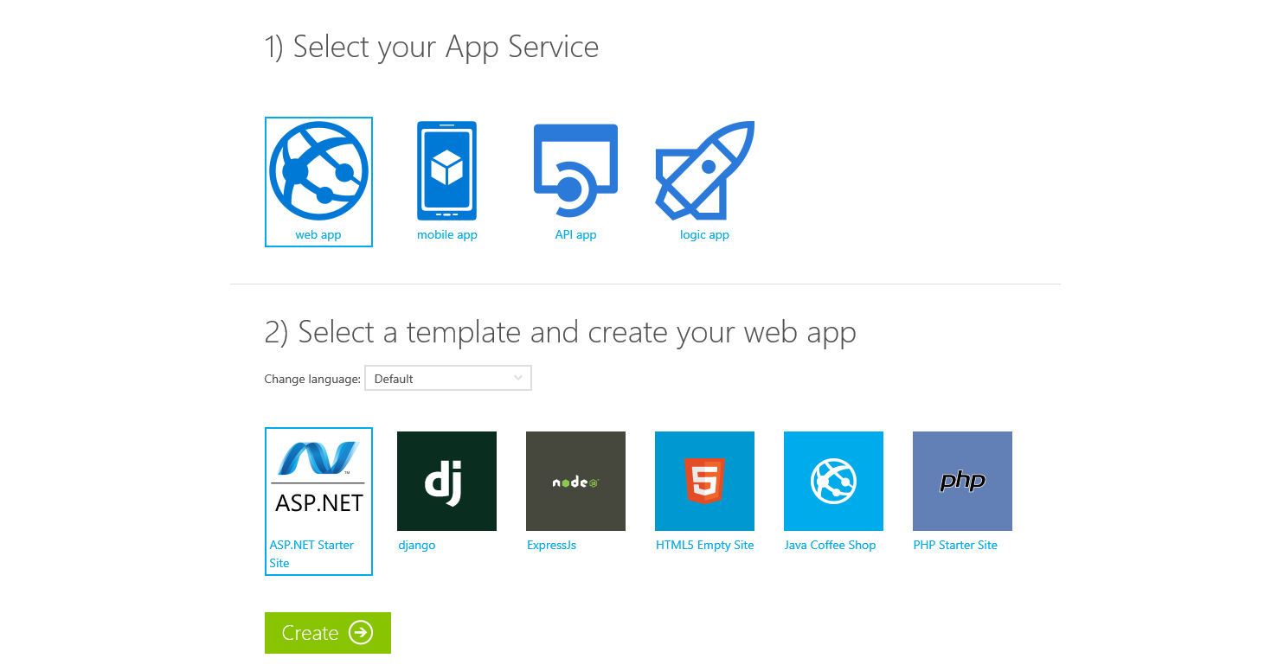
Try App Service Today
https://tryappservice.azure.com
Free
No Signup or Account Required

Slide 19



Azure App Service Web Apps
Start simple
Code smart
Go live
Easily create and scale your new sites in seconds
Automatically scale your sites that scale with your business
Quickly improve performance and reduce latency with right resources
Built-in web jobs support
Leverage existing skills – Languages and databases you know
Start with open source apps and frameworks
Develop with VS and WebMatrix
Supports X-Plat development
Improve developer productivity through continuous automated deployment
Built-in monitoring of perf and usage data
Built-in diagnostics to assist with debugging
Built for DevOps
Office Blog ASP.NET site microsoft.com
Notes:
Speaker notes:
Start simple
Emphasize rapid deployment of Web Apps from choice of Asp.Net starter applications to thousands of pre-built certified, opensource, and community software applications, add-ons, and data analysis platforms pre-configured for Azure.
Explain how Web Apps use automatic load balancing to scale out.
With Web Apps its easy to scale out automatically with increasing instance count using autoscale features e.g. CPU Load, scheduled
Easily improve performance of Web Apps and reduce latency of by changing to right instance size with zero downtime
Supports cron jobs
Code smart
Leverage existing skills to start coding for Web Apps without expensive retraining:
Languages: .NET, Java, NodeJS, PHP, Python. Databases: SQL Server, MySql .
Start coding with any development tools on any platforms such as Linux, OSX and Windows.
Go live
Built for DevOps – Agility through continuous deployment.
Encourages iterative development and improves developer productivity through continuous automated deployment enabled by Web Apps’ integrated source control connectivity to Team Foundation Server(TFS) and Git.
Easily monitor key performance metrics in a verbose or minimal fashion. Easily access monitoring data from a storage account externally for further analysis.
Easily enable diagnostics logging and add instrumentation. Easy access to information logged.

Slide 20







Azure App Service Mobile Apps
Provides essential services to support client development
Client Support
iOS
Android
HTML5/Web
Xamarin
Windows
Windows Phone
PhoneGap
Sencha
Storage
Authentication
Logic
Push
Scheduler
Notes:
Speaking Notes
Azure Mobile Services is a Backend-as-a-Service
Instead of you having to design, build, test, deploy, manage, and upgrade your whole backend, we do it for you
Features of Mobile Services
Storage – SQL DB
Authentication – built in support for social providers w/ ability to custom auth
Backend logic – data validation, logical flows, etc
Push Notifications – across all major mobile platforms
Scheduler – backend job processing

Slide 21










Microsoft Azure
SAAS Solutions
Microsoft Dynamics
Data + Analytics
Data
Analytics
Enterprise Mobility
Microsoft Enterprise Mobility Suite
SQL Database
SQL Data Warehouse
HDInsight
Data Factory
DocumentDB
Data Lake
Machine Learning
Mobile Engagement
Developer + App Platform
Visual Studio Family + Azure App Service
Redis Cache
Tables
Search
Data + Analytics
Cortana Analytics Suite
Internet of Things
Azure IoT Suite
Cloud Infrastructure
Azure + Azure Stack + Operations Management Suite

Slide 22

Microsoft Azure
SAAS Solutions
Microsoft Dynamics
Enterprise Mobility
Microsoft Enterprise Mobility Suite
Developer + App Platform
Visual Studio Family + Azure App Service
Internet of Things
IoT Hub
Stream Analytics
Logic Apps
Data + Analytics
Cortana Analytics Suite
Internet of Things
Azure IoT Suite
Cloud Infrastructure
Azure + Azure Stack + Operations Management Suite

Slide 23


Key Scenarios to get started with Microsoft Azure
Full Dev/Test environments
Build
Production
Visual Studio Online
Master branch
GIT / TFS
Staging
Check-in
Test branch
Dev/Test
Developers
Notes:
Speaker notes:
Create full Dev, Test, Staging and Production environments in minutes
Availability of Visual Studio Online(VSO) integration with build option available
Validate web app changes in a staging or test deployment slot before swapping it with the production slot
Swap to get your "last known good site" instantaneously if there is a problem with a new deployment in production
Swapping to production from staging as opposed to direct deployment eliminates downtime
Dev, Test, Staging and Production deployment workflow can be automated when pre-swap validation isn’t needed

Slide 24



Key Scenarios to get started with Microsoft Azure
Microsoft SQL Server
VM
Microsoft SQL Server
VM
Microsoft Azure
Lift and Shift
Application VM
Storage
Corporate
Network
Application VM
Archive
key data inexpensively
PDF
JPG
VIDEO
DB
DOCX
Notes:
Speaker notes:
Lift and Shift
Take existing work loads and run them in a certified instance. Emphasize image mobility and Azure Files to help move applications that require SMB shared folders very easily to Azure.
Storage
Archive key data in inexpensive cloud storage. Mention corporate finance databases, industry compliance documents and other key data can be inexpensively archived to Azure storage.

Slide 25

Key Scenarios to get started with Microsoft Azure
HDInsight
Visualization
and reporting
tools
Input
Process
Results
Output
Iterative exploration - Process key data into business intelligence using Hadoop
Notes:
Speaker notes:
Iterative exploration
The source data files(log files, email messages, tweets, and more) are loaded into the cluster, processed by one or more queries within HDInsight, and the output is consumed by the chosen reporting and visualization tools. The cycle repeats using the same data until useful insights have been found, or it becomes clear that there is no useful information available from the data—in which case you might choose to restart the process with a different source dataset.

Slide 26












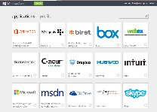

Key Scenarios to get started with Microsoft Azure
Identity as a Service
SaaS
Active Directory
Active Directory
Synchronize and
consolidate
identities
Custom LOB apps
ISV/CSV apps
Azure App Service and Non-MS cloud-based apps
PCs and devices
Notes:
Speaker notes:
Identity as a Service; Control and protect your apps, data and services in Azure together with assets in non-MS cloud using a single AD account.
Consolidate all your identities using one account for single sign-on to any cloud and on-premises services, using your favorite device, including iOS, Mac OS X, Android, and Windows devices.
As a developer you must also need to understand implications of extending your credentials in on-premises Active Directory to Azure Active Directory to protect your assets in on-premises and in the cloud.

Slide 27



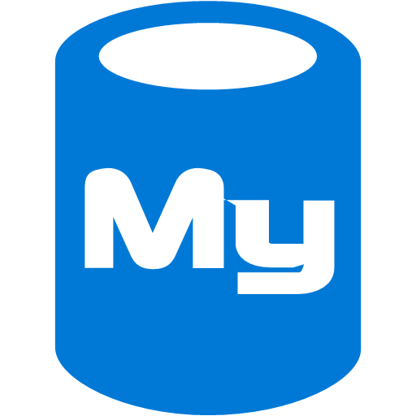



On-premises /
Hosting Services
IIS/SQL Server Based
Web Apps
Microsoft
SQL
Server
IIS
Non-IIS Open Source
Web Apps
Microsoft Azure
MySql
Web Apps - Take your web apps to the cloud using inexpensive App Service Web Apps
Key Scenarios to get started with Microsoft Azure
Notes:
Speaker notes:
You can easily move your existing IIS based web apps including SQL Server databases to Azure App Service easily with a migration tool provided by Microsoft called Azure App Service Migration Assistant.
If your open source web app’s framework is supported on App Service, the languages and frameworks needed by your application are configured for you automatically. Migrate an existing application or create a new one from the Application Gallery.
Consider using Azure Cloud Services or IaaS Virtual Machines if you are unable to migrate your application via Migration Assistant or your open source web app’s framework isn’t supported on App Service.
Other notes:
Windows Server 2003 will reach end of support on July 14th 2015. If you are currently hosting your websites on an IIS server that is Windows Server 2003, Web Apps is a low-risk, low-cost, and low-friction way to keep your websites online, and Web Apps Migration Assistant can help automate the migration process for you.
Moving to Web Apps require less time and IT expertise to configure and secure your apps compared to apps running in VM environment.
Web Apps require no maintenance effort on your part to patch, update, and manage underlying VM environment.

